Slide 1
SBP CIRC. # 5, TECHNOLOGY GOVERNANCE FRAMEWORK
SBP TECHNOLOGY GOVERNANCE AND RISK MANAGEMENT FRAMEWORK

Slide 2
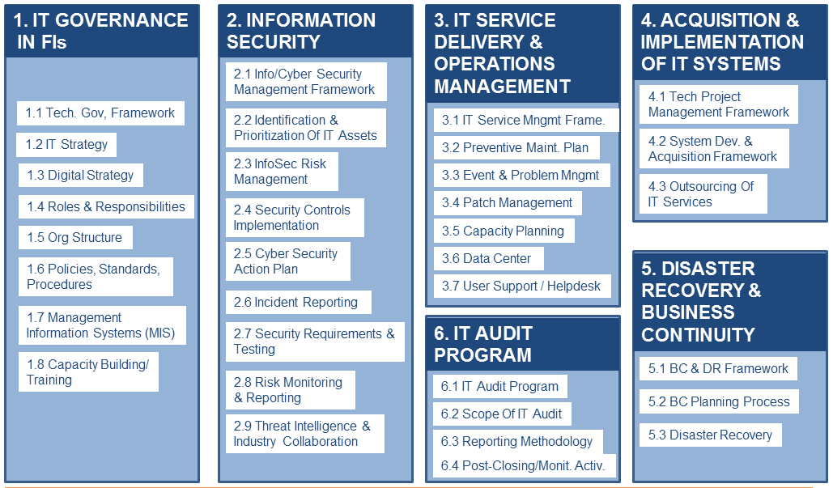
SBP CIRC. # 5, TECHNOLOGY GOVERNANCE FRAMEWORK

Slide 3
SBP CIRC. # 5, TECHNOLOGY GOVERNANCE FRAMEWORK
OBJECTIVES
The framework aims to provide enabling regulatory environment for managing risks associated with the acquisition, development, deployment and use of technology and shall serve as SBP's baseline requirements for all FI(s).

Slide 4
SBP CIRC. # 5, TECHNOLOGY GOVERNANCE FRAMEWORK
OBJECTIVES
The FI(s) shall upgrade their systems, controls and procedures to ensure compliance with this framework latest by June 30, 2018.

Slide 5
SBP CIRC. # 5, TECHNOLOGY GOVERNANCE FRAMEWORK
OBJECTIVES
The FI(s) shall assess and conduct a gap analysis between their current status & this framework and draw a time-bound action plan to address the gaps and comply with the guidelines in this framework

Slide 6
SBP CIRC. # 5, TECHNOLOGY GOVERNANCE FRAMEWORK
OVERVIEW
The instructions are focused on enhancing the proactive and reactive environments in FI(s) to various facets and dimensions of technology including information security, technology operations, audit, business continuity, …

Slide 7
SBP CIRC. # 5, TECHNOLOGY GOVERNANCE FRAMEWORK
OVERVIEW
…project/performance management and related domains (pg 5)
FI(s) shall adopt an integrated risk management approach to identify, measure, monitor and control technology risks (page 5)

Slide 8
SBP CIRC. # 5, TECHNOLOGY GOVERNANCE FRAMEWORK
OVERVIEW
The Framework consists of 6 domains and 35 sub-domains
Overall the Framework is a combination of COBIT, ITIL, and ISO27001:2013 (ISMS)

Slide 9
SBP CIRC. # 5, TECHNOLOGY GOVERNANCE FRAMEWORK
Implementation Mechanism
Gap analysis
Documentation
Implementation
END

